Slide 1
Soar Project
Flight Reservation and Management System Software
D’Ignazio Donato
Li Yifeng
Meduri Lorenzo
Pedrotti Filippo
Software Engineering University of Trento 23/06/2026

Slide 2
Project Overview
Project Objectives:
Check available flights
Ticket purchase and management
Route planning and administrative tasks
Main Users:
Registered Users / Travel Agencies
Admins
Developers
Summary of main Functionalities:
Searching Flights
Purchasing Tickets
Managing Account
Editing Flights Database
Backup of Database

Slide 3
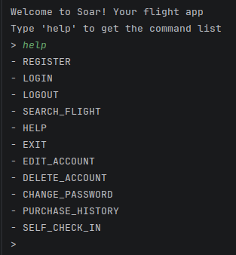
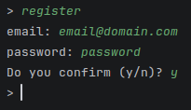
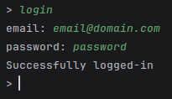
User Interface
(CLI)
For unregistered users:
Creation of Account
Access to Account
View and search of Flights
Software Engineering University of Trento 23/06/2026

Slide 4
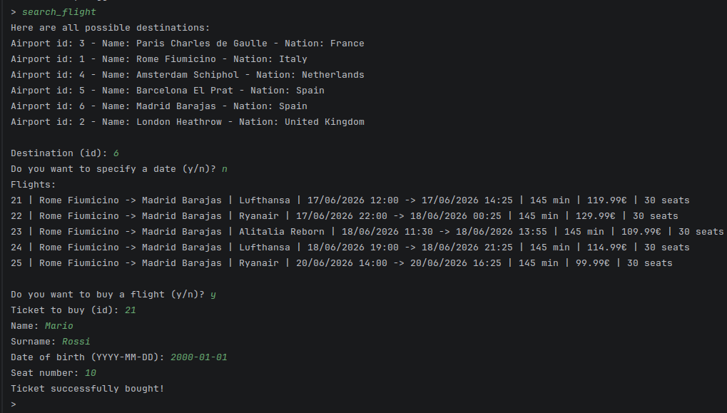

User Interface
(CLI)
For normal registered users and travel agencies:
View and search of Flights
Purchase of Tickets
View of purchase History
Account Management
Self check-in for Tickets
Software Engineering University of Trento 23/06/2026

Slide 5
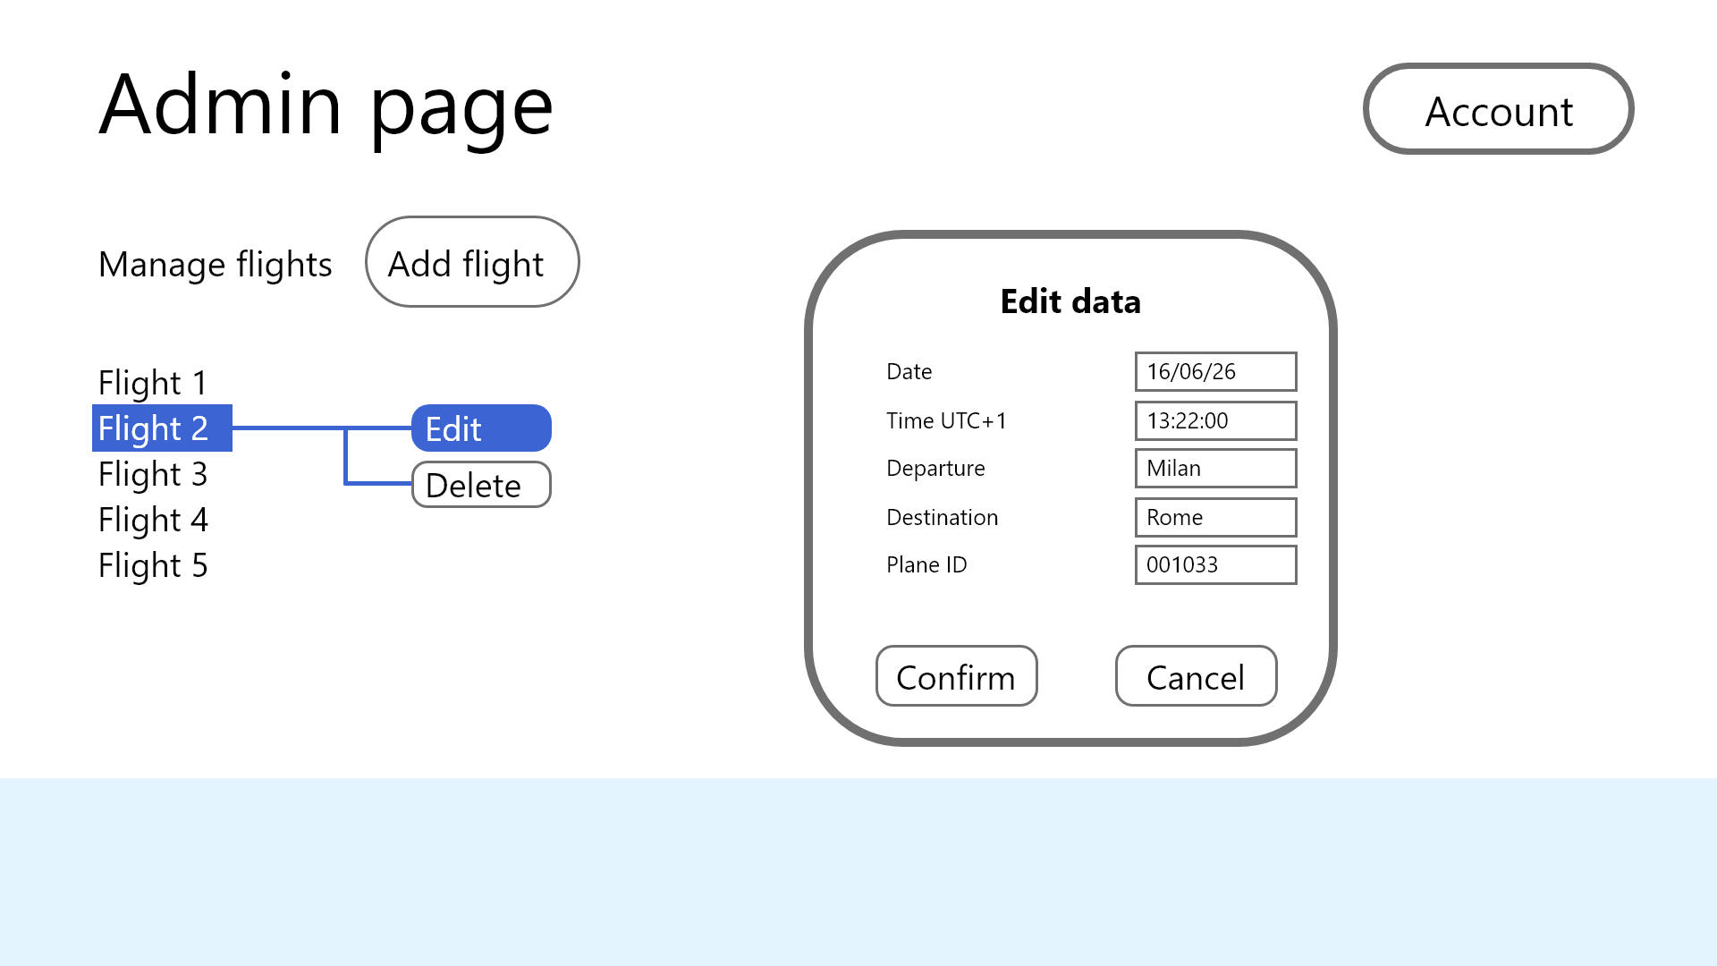
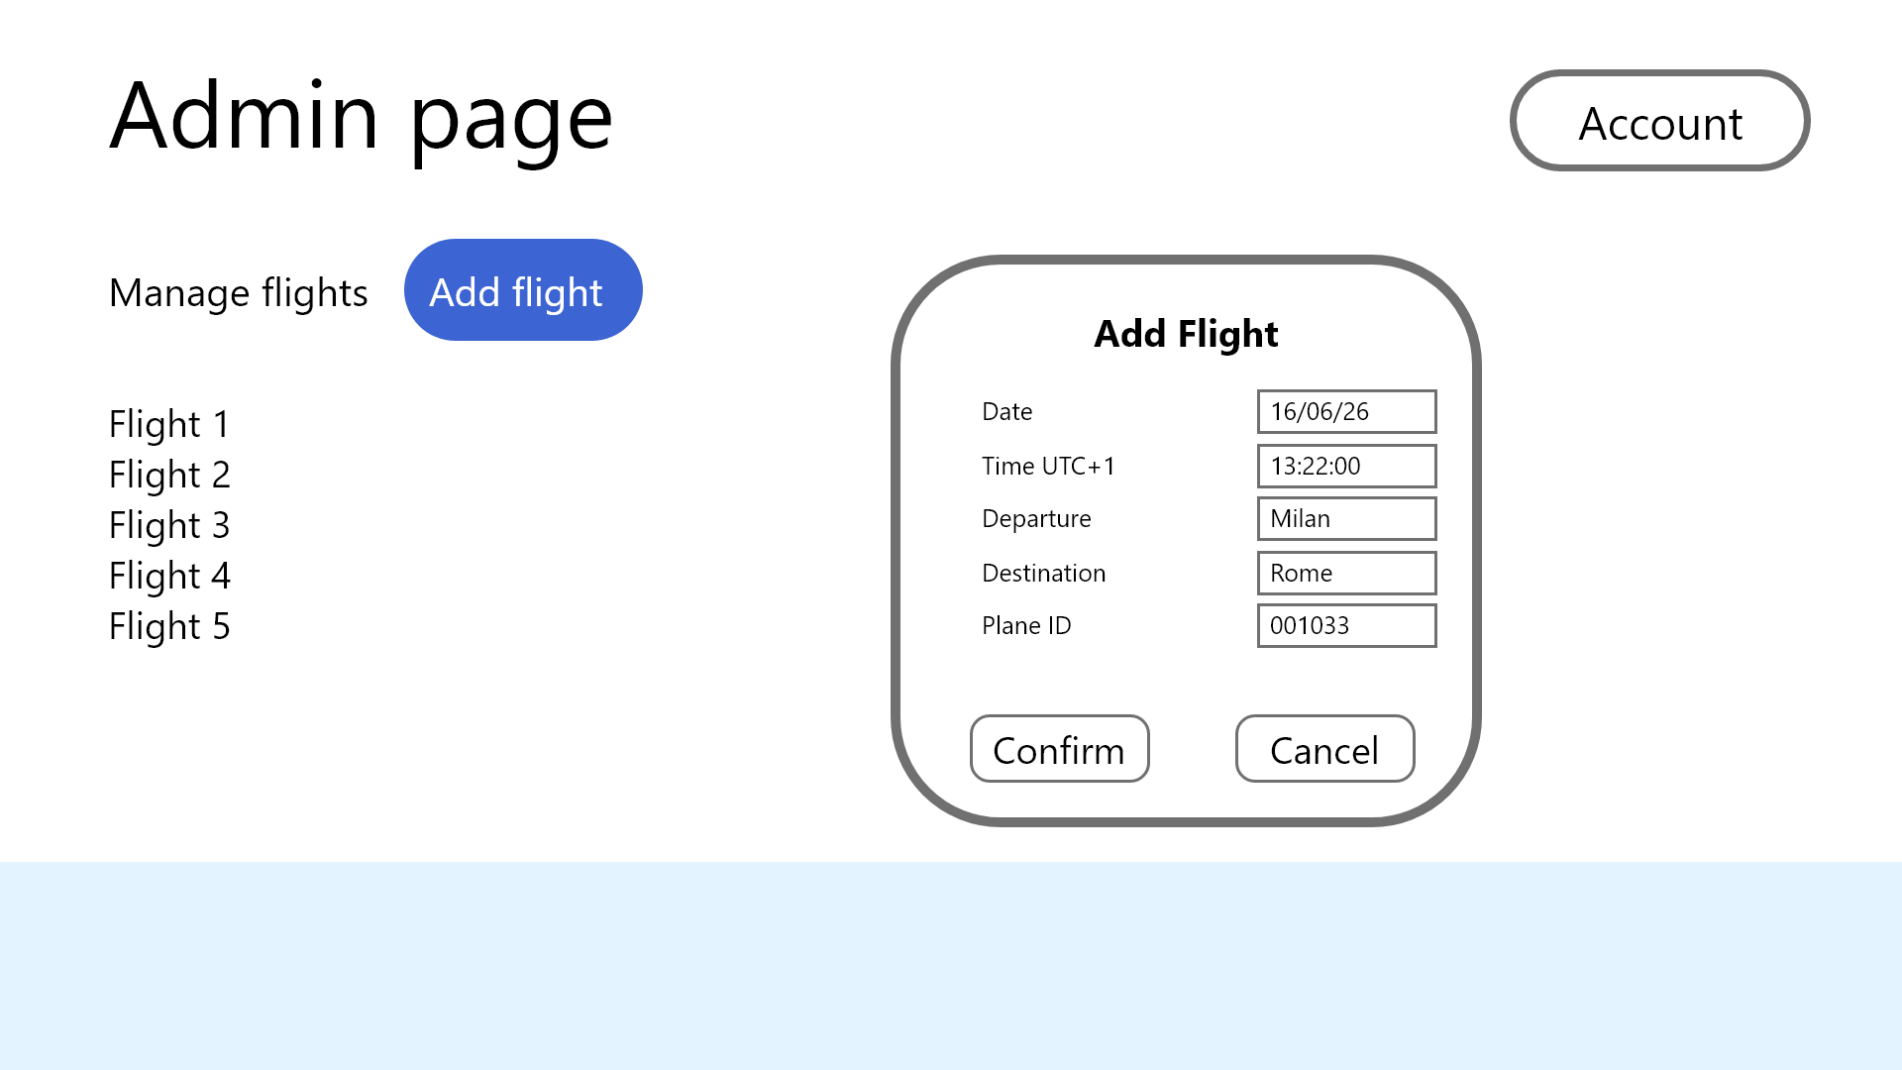
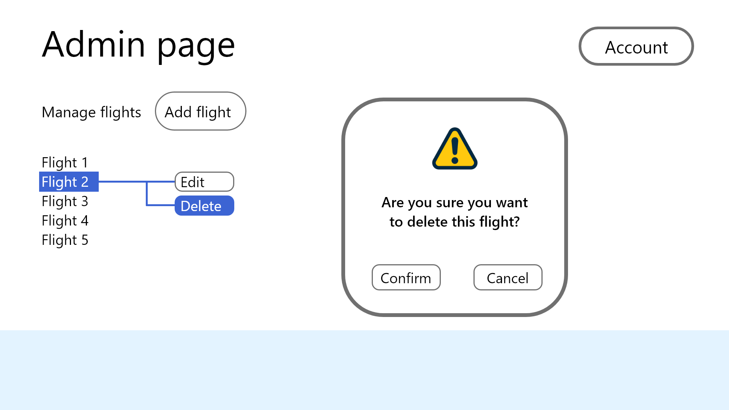
Admin Interface
(Mockup)
Analysis of Data
Add Flight
Edit existing Flights
Delete existing Flight
Software Engineering University of Trento 23/06/2026

Slide 6
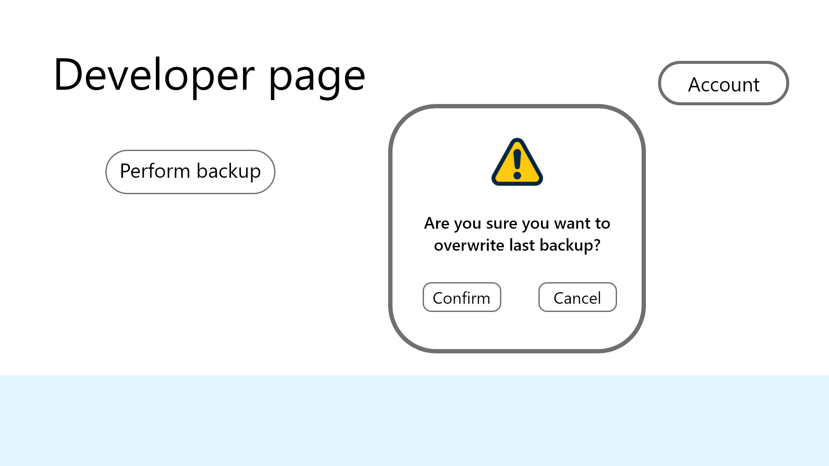
Developer Interface
(Mockup)
Creation of Backups
Software Engineering University of Trento 23/06/2026

Slide 7
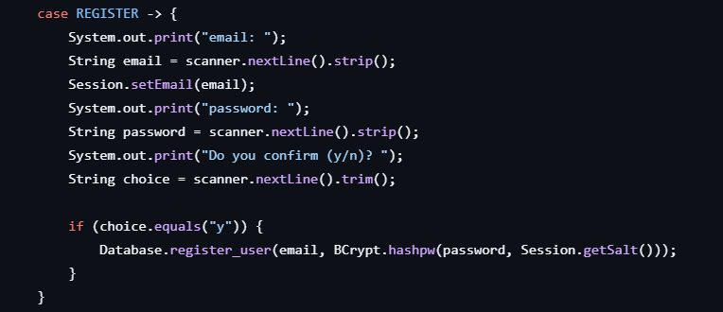
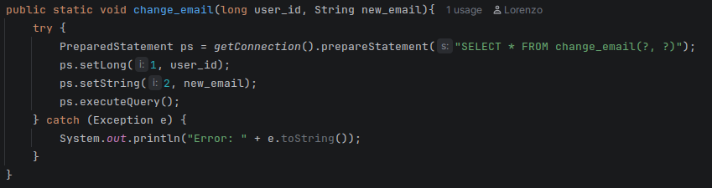
Security
Usage of secure functions to prevent sql injections
Usage of hash functions to store passwords safely

